Slide 1
Smarty – Extendable Framework for Bilingual and Multilingual Comprehension Assistants
Todor Arnaudov*, Ruslan Mitkov**
* Plovdiv University, Email tosh.bg@gmail.com
** University of Wolverhampton, Email r.mitkov@wlv.ac.uk

Slide 2

The problem with conventional and electronic dictionaries
User is presented with list of possible meanings for every word under consideration
⇒ This could cause confusion or misunderstanding.

Slide 3
Comprehension assistants
Locolex (Feldweg and Breidt 1996)
MobiMouse (Morphologic)
SmartDict (Kolev, 2005)

Slide 4


Smarty:
reducing the number of possible senses
Find a meaning/translation of a word in a standard dictionary?
Run: 80 different senses
POS-tagging: senses/translations reduced from 80 to 21
Word-sense disambiguation: translations reduced from 21 to 1
Standard
Parts of speech
Word Sense Disambiguation

Slide 5
Smarty – distinctive features
Inspired by Locolex
Language pair: English-Bulgarian
Hybrid system: elaborate interface operating in 2 modes: comprehension assistant and conventional electronic dictionaries with extra features
Extendable/portable to other languages
Lexicographical resource: WordNet (BalkaNet)

Slide 6
Smarty: NLP tasks
POS-tagging
Lemmatisation and normalisation
Multiword expressions recognition
Word-sense disambiguation

Slide 7
Word Sense Disambiguation
User Interface (Input)
Pointing an English word in a context
User Interface (Output)
Bulgarian translation and gloss suggested
Context
Tokenisation
Lemmatisation/Normalisation
Stop words cleaning
POS-tagging
WordNet and BalkaNet
WordNet/BalkaNet alignment
WordNet
WordNet synset for the found word
Glosses extraction
English WSD
The Gloss with the most matches suggested
Glosses
Tokenisation
Lemmatisation/Normalisation
Stop words cleaning
POS-tagging
Context and Glosses
Word Matching
Matches Counted

Slide 8
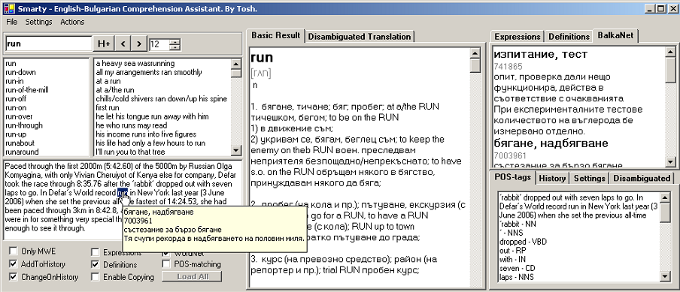
Smarty’s Interface

Slide 9
User evaluation
Comparative evaluation: comparison with SA Dictionary and Babylon.
User evaluation figures: average word query time
Users: undergraduate student, PhD student

Slide 10
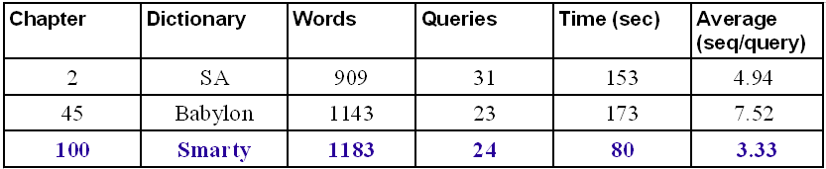
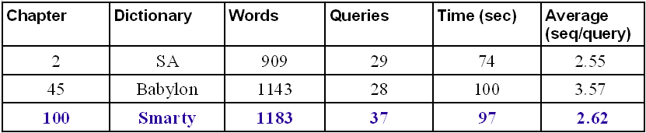
Evaluation results
Chapters from Dan Brown’s The Da Vinci Code
User 1 – Undergraduate student
User 2 – PhD student

Slide 11
Conclusion
Comparative evaluation shows that users need less time for querying unknown words and multiword expressions.
The alignment between the lexical databases WordNet, BalkaNet and EuroWordNet allows extension with other languages

